Slide 1
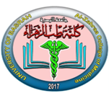
University of Basrah
Al-Zahraa College of Medicine
Ministry of higher Education and Scientific Research
Academic year 2022-2023
Acute Care Block
Day: Monday Date:12/9/2022
poisoning
By dr. Mohammed adel
References: Davidsons’ principle of internal medicine

Slide 2
University of Basrah
Al-Zahraa College of Medicine
Ministry of higher Education and Scientific Research
Acute poisoning is common, accounting for about 1% of hospital admissions.
most frequent cause is intentional drug overdose in the context of self-harm, often involving prescribed or ‘over-the-counter’ medicines.
Accidental poisoning is also common, especially in children and the elderly
Poisoning is a major cause of death in young adults, but most deaths occur before patients reach medical attention, and mortality is low (< 1%) in those admitted to hospital

Slide 3
University of Basrah
Al-Zahraa College of Medicine
Ministry of higher Education and Scientific Research
Clinical assessment and investigations
History and examination are described on following paragraph. Occasionally, patients may be unaware of or confused about what they have taken, or may exaggerate (or, less commonly, underestimate) the size of the overdose, but rarely mislead medical staff deliberately.
Poisoning is a common cause of coma, especially in younger people, but it is important to exclude other potential causes.

Slide 4
University of Basrah
Al-Zahraa College of Medicine
Ministry of higher Education and Scientific Research
Urea, electrolytes and creatinine should be measured in all patients with suspected systemic poisoning.
Arterial blood gases should be checked in those with significant respiratory or circulatory compromise, or after poisoning with substances likely to affect acid–base status.
Calculation of anion and osmolar gaps may help to inform diagnosis and management.
Potent oxidising agents may cause methaemoglobinaemia, with consequent blue discoloration of skin and blood, and reduced oxygen delivery to the tissues.

Slide 5
University of Basrah
Al-Zahraa College of Medicine
Ministry of higher Education and Scientific Research

Slide 6
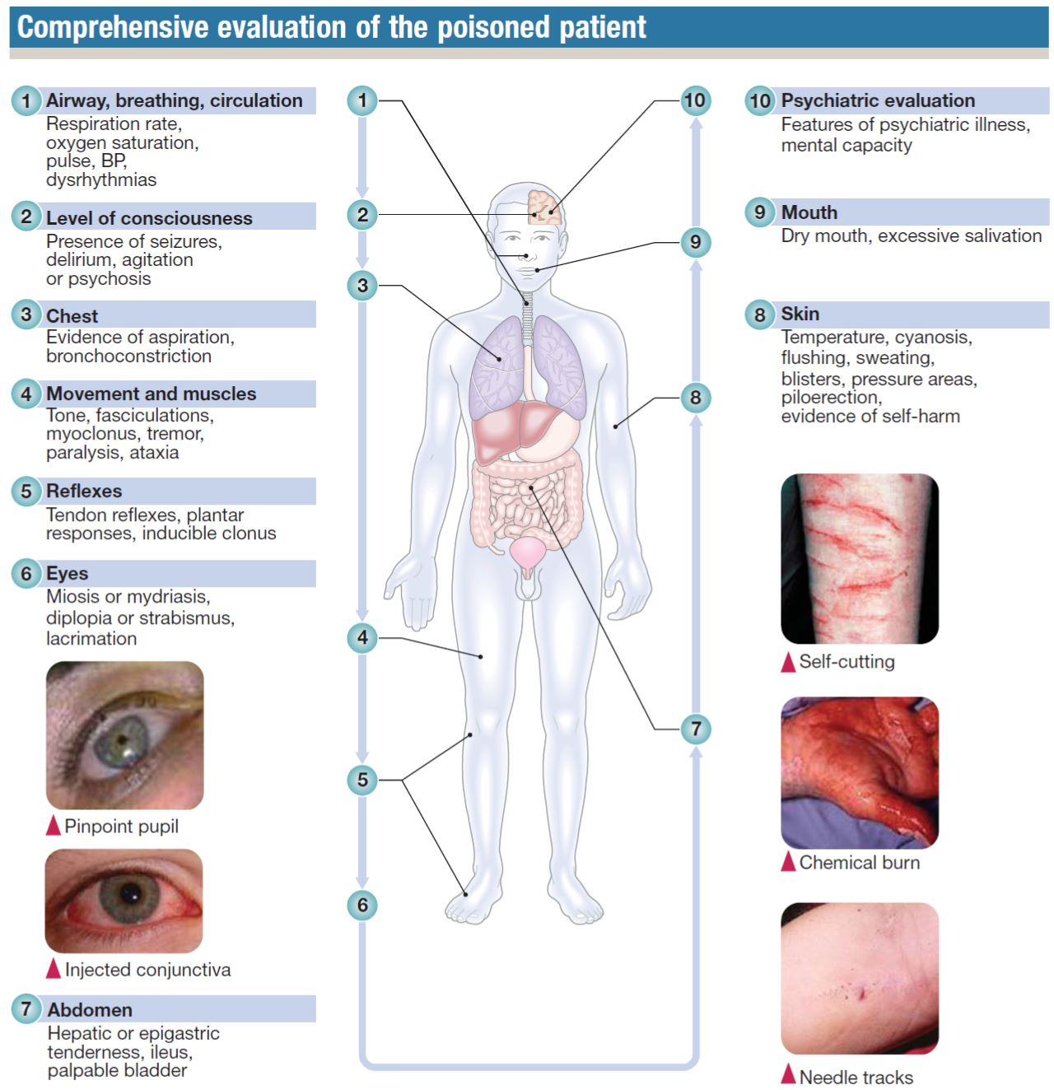
University of Basrah
Al-Zahraa College of Medicine
Ministry of higher Education and Scientific Research

Slide 7
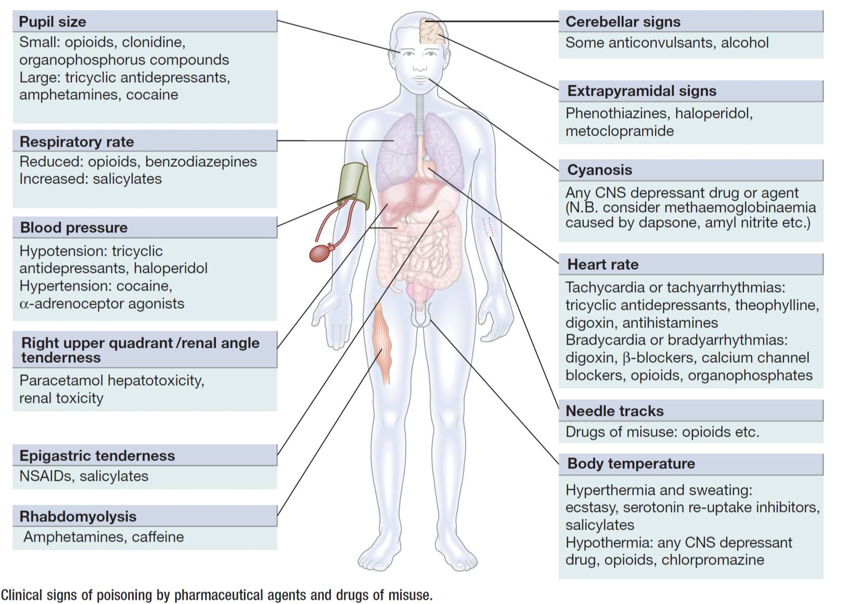
University of Basrah
Al-Zahraa College of Medicine
Ministry of higher Education and Scientific Research

Slide 8
University of Basrah
Al-Zahraa College of Medicine
Ministry of higher Education and Scientific Research
General management
Patients presenting with eye/skin contamination should undergo local decontamination measures.
Gastrointestinal decontamination
Patients who have ingested potentially life-threatening quantities of toxins may be considered for gastrointestinal decontamination if poisoning has been recent.

Slide 9
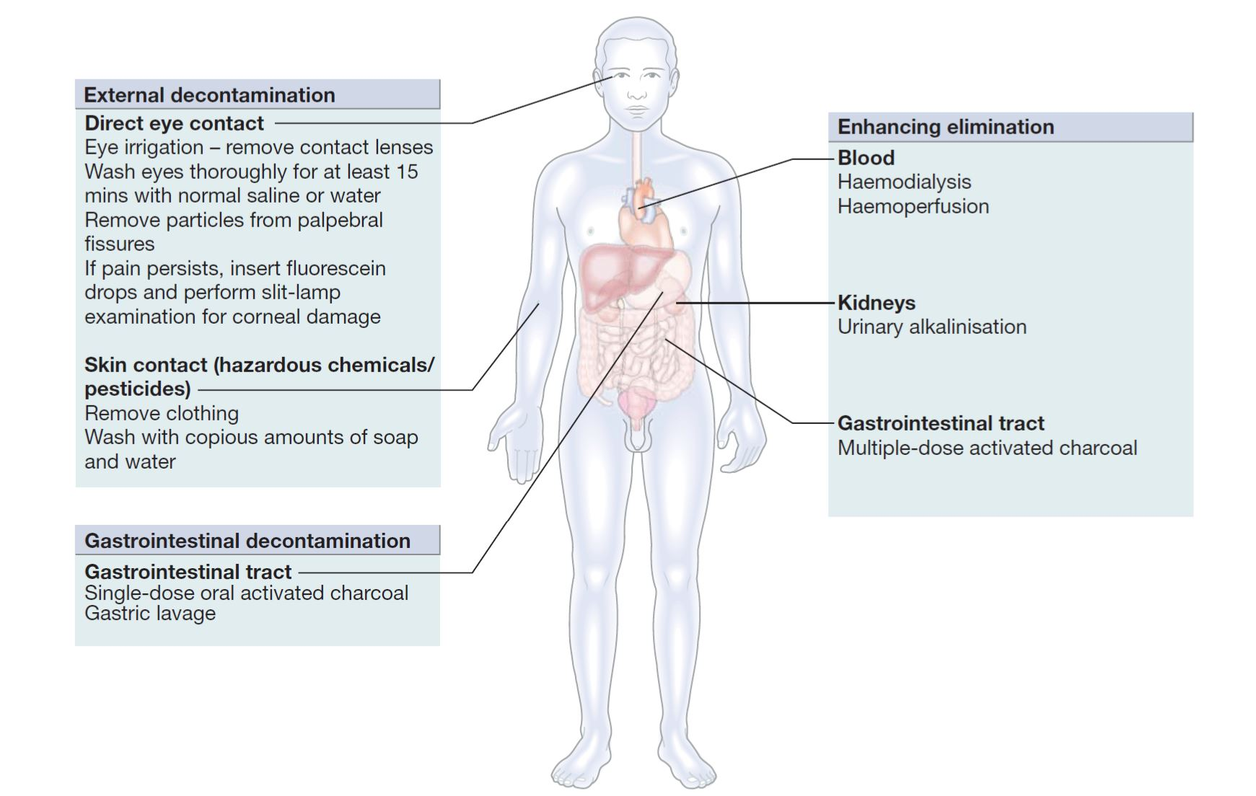
University of Basrah
Al-Zahraa College of Medicine
Ministry of higher Education and Scientific Research

Slide 10
University of Basrah
Al-Zahraa College of Medicine
Ministry of higher Education and Scientific Research
Activated charcoal
Given orally.
activated charcoal absorbs toxins in the bowel as a result of its large surface area.
efficacy decreases with time and current guidelines do not encourage use more than 1 hour after overdose, unless a sustained-release preparation has been taken or when gastric emptying may be delayed.
In patients with impaired swallowing or a reduced level of consciousness, activated charcoal, even via a nasogastric tube, carries a risk of aspiration pneumonitis, which can be reduced (but not eliminated) by protecting the airway with a cuffed endotracheal tube.
Multiple doses of oral activated charcoal (50 g 6 times daily in an adult) may enhance the elimination of some substances at any time after poisoning

Slide 11
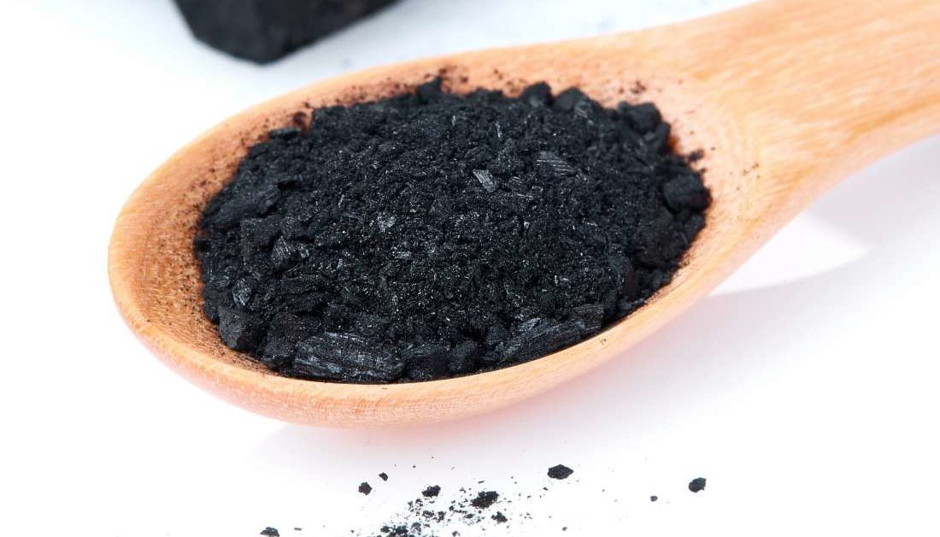
University of Basrah
Al-Zahraa College of Medicine
Ministry of higher Education and Scientific Research

Slide 12
University of Basrah
Al-Zahraa College of Medicine
Ministry of higher Education and Scientific Research
Gastric aspiration and lavage
Gastric aspiration and/or lavage is very infrequently indicated in acute poisoning, as it is no more effective than activated charcoal for most substances and complications are common, especially pulmonary aspiration.
It is contraindicated if strong acids, alkalis or petroleum distillates have been ingested.
Use may be justified for life-threatening overdoses of those substances that are not absorbed by activated charcoal

Slide 13
University of Basrah
Al-Zahraa College of Medicine
Ministry of higher Education and Scientific Research
Whole bowel irrigation
This involves the administration of large quantities of osmotically balanced polyethylene glycol and electrolyte solution (1–2 L/ hr for an adult), usually by a nasogastric tube, until the rectal effluent is clear.
It is occasionally indicated to enhance the elimination of ingested packets of illicit drugs or slow-release tablets such as iron and lithium that are not absorbed by activated charcoal.
Contraindications include inadequate airway protection, haemodynamic instability, gastrointestinal haemorrhage, obstruction or ileus. Whole bowel irrigation may precipitate nausea and vomiting, abdominal pain and electrolyte disturbances

Slide 14
University of Basrah
Al-Zahraa College of Medicine
Ministry of higher Education and Scientific Research
Urinary alkalinisation
Urinary excretion of weak acids and bases is affected by urinary pH.
If the urine is alkalinised (pH > 7.5) by the administration of sodium bicarbonate (e.g. 1.5 L of 1.26% sodium bicarbonate over 2 hrs), weak acids (e.g. salicylates, methotrexate) are highly ionised, resulting in enhanced urinary excretion.
Urinary alkalinisation is currently recommended for patients with clinically significant salicylate poisoning when the criteria for haemodialysis are not met.
It is also sometimes used for poisoning with methotrexate.
Complications include alkalaemia, hypokalaemia and occasionally alkalotic tetany.

Slide 15
University of Basrah
Al-Zahraa College of Medicine
Ministry of higher Education and Scientific Research
Haemodialysis and haemo-perfusion
These techniques can enhance the elimination of poisons that have a small volume of distribution and a long half-life after overdose; use is appropriate when poisoning is sufficiently severe.
Lipid emulsion therapy
Lipid emulsion therapy is increasingly used for poisoning with lipid-soluble agents, such as local anaesthetics, tricyclic antidepressants, calcium channel blockers and lipid-soluble β-adrenoceptor antagonists (β-blockers) such as propranolol.

Slide 16
University of Basrah
Al-Zahraa College of Medicine
Ministry of higher Education and Scientific Research
Supportive care
For most poisons, antidotes and methods to accelerate elimination
are inappropriate, unavailable or incompletely effective. Outcome
is dependent on appropriate nursing and supportive care, and treatment of complications.
Antidotes
Antidotes are available for some poisons and work by a variety of mechanisms The use of some of these in the management of specific poisons is described below.

Slide 17
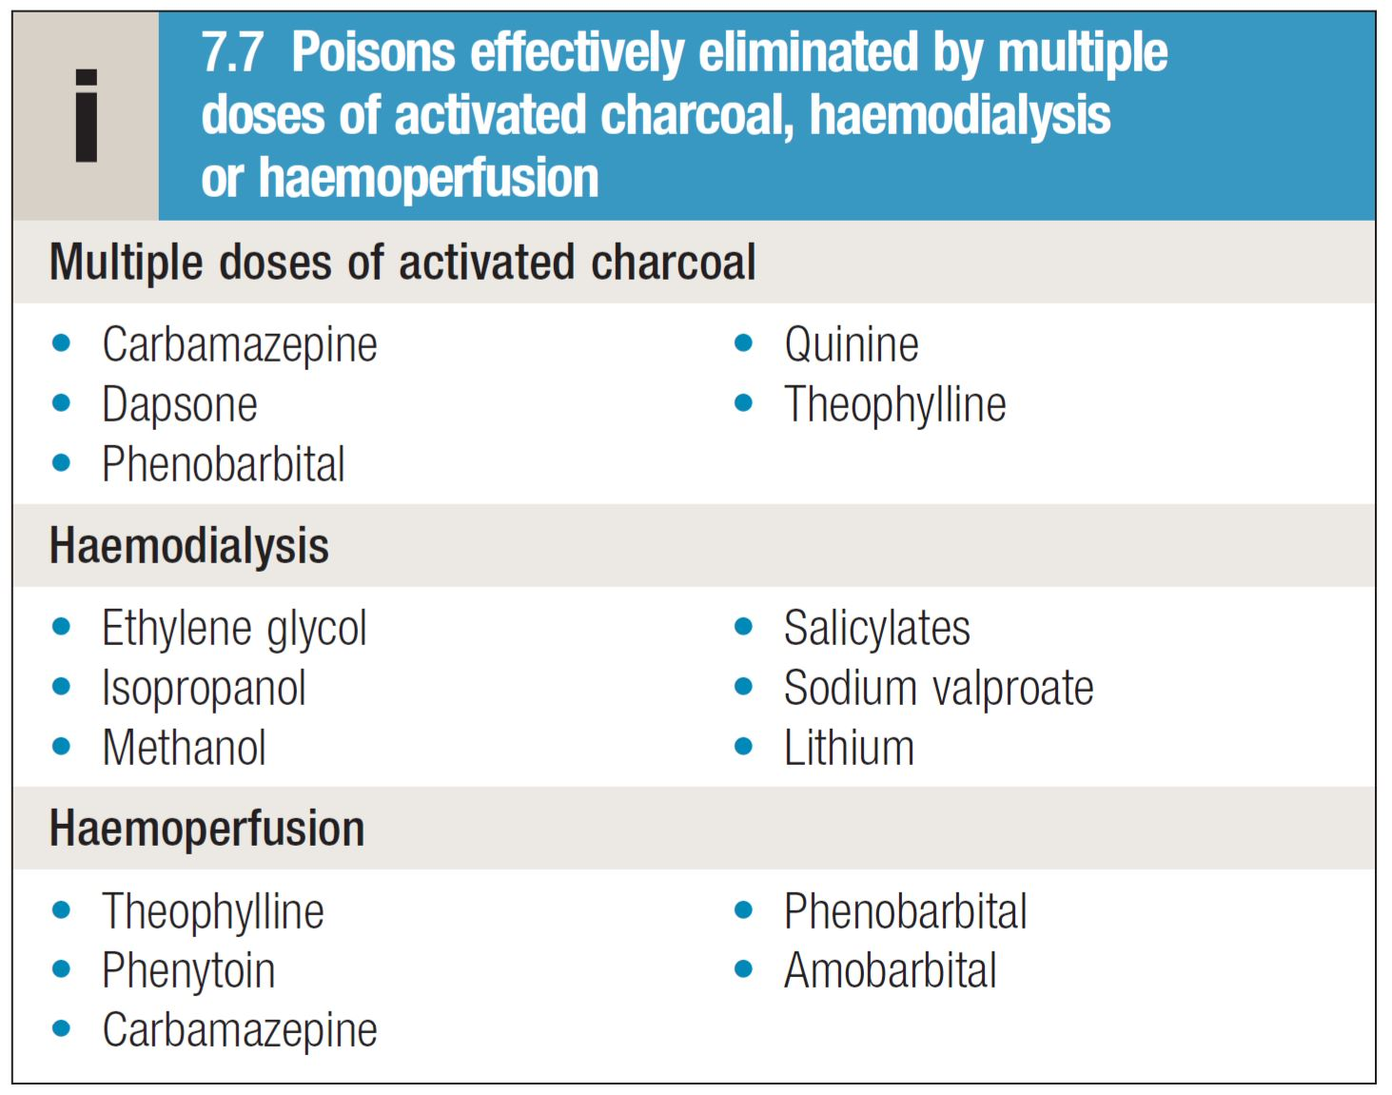
University of Basrah
Al-Zahraa College of Medicine
Ministry of higher Education and Scientific Research

Slide 18
University of Basrah
Al-Zahraa College of Medicine
Ministry of higher Education and Scientific Research
Poisoning by specific pharmaceutical agents:
Paracetamol (acetaminophen)
Paracetamol is one of the most common drugs use in overdose.
Toxicity is caused by an intermediate reactive metabolite that binds covalently to cellular proteins, causing cell death.
This results in hepatic and occasionally renal failure.
In therapeutic doses, the toxic metabolite is detoxified in reactions requiring glutathione, but in overdose, glutathione reserves become exhausted.

Slide 19
University of Basrah
Al-Zahraa College of Medicine
Ministry of higher Education and Scientific Research
Activated charcoal may be used in patients presenting within 1 hour.
Antidotes for paracetamol act by replenishing hepatic glutathione and should be administered to all patients with acute poisoning and paracetamol concentrations above a ‘treatment line’.
Acetylcysteine given intravenously (or orally in some countries) is highly efficacious if administered within 8 hours of the overdose.
Efficacy declines thereafter, so administration should not be delayed in patients presenting after 8 hours to await a paracetamol blood concentration result.

Slide 20
University of Basrah
Al-Zahraa College of Medicine
Ministry of higher Education and Scientific Research
Liver and renal function, International Normalised Ratio (INR) and a venous bicarbonate should also be measured.
Arterial blood gases and lactate should be assessed in patients with reduced bicarbonate or severe liver function abnormalities; metabolic acidosis indicates severe poisoning.
An alternative antidote is methionine 2.5 g orally (adult dose) every 4 hours to a total of four doses, but this may be less effective, especially after delayed presentation.
Liver transplantation should be considered for paracetamol poisoning with life-threatening liver failure.

Slide 21
University of Basrah
Al-Zahraa College of Medicine
Ministry of higher Education and Scientific Research
Salicylates (aspirin)
Clinical features
Salicylate overdose commonly causes nausea, vomiting, sweating, tinnitus and deafness.
Direct stimulation of the respiratory centre produces hyperventilation and respiratory alkalosis
Peripheral vasodilatation with bounding pulses and profuse sweating occurs in moderately severe cases. Serious poisoning is associated with metabolic acidosis, hypoprothrombinaemia, hyperglycaemia, hyperpyrexia, renal failure, pulmonary oedema, shock and cerebral oedema.
Toxicity is enhanced by acidosis, which increases salicylate transfer across the blood–brain barrier.

Slide 22
University of Basrah
Al-Zahraa College of Medicine
Ministry of higher Education and Scientific Research
Management
Activated charcoal.
The plasma salicylate concentration should be measured at least 2 (symptomatic patients) or 4 hours (asymptomatic patients).
Dehydration should be corrected carefully because of the risk of pulmonary oedema. Metabolic acidosis should be treated with intravenous sodium bicarbonate (8.4%), after plasma potassium has been corrected.
Urinary alkalinisation is indicated for adults with salicylate concentrations above 500 mg/L.
Haemodialysis when serum concentrations are above 700 mg/L in adults with severe toxic features, or in renal failure, pulmonary oedema, coma, convulsions or refractory acidosis.

Slide 23
University of Basrah
Al-Zahraa College of Medicine
Ministry of higher Education and Scientific Research
Benzodiazepines
Benzodiazepines (e.g. diazepam) are of low toxicity when taken alone in overdose but can enhance CNS and respiratory depression when taken with other sedative agents, including alcohol.
They are more hazardous in the elderly and those with chronic lung or neuromuscular disease.
The specific benzodiazepine antagonist flumazenil (0.5 mg IV, repeated if needed) increases conscious level in patients with benzodiazepine overdose, but carries a risk of seizures and is contraindicated in patients co-ingesting pro-convulsants.

Slide 24
University of Basrah
Al-Zahraa College of Medicine
Ministry of higher Education and Scientific Research
Organophosphorus insecticides and nerve agents
Organophosphorus (OP) compounds) are widely used as pesticides, especially in developing countries.
Case fatality following deliberate ingestion is high (5–20%).
The toxicology and management of nerve agent and pesticide poisoning are similar.
OP compounds inactivate acetylcholinesterase (AChE), resulting in the accumulation of acetylcholine (ACh) in cholinergic synapses.
Exposure is confirmed by measurement of plasma or red blood cell cholinesterase activity but antidote use should not be delayed pending results.

Slide 25
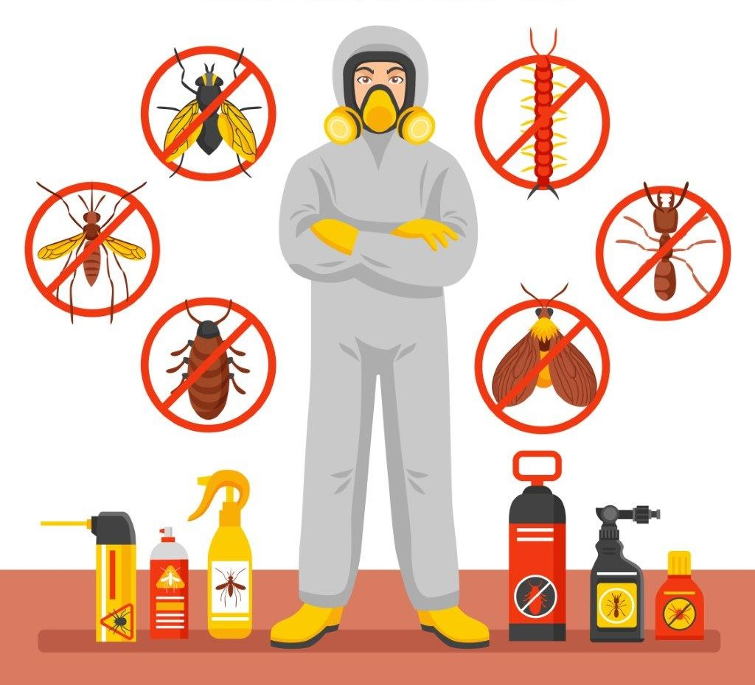
University of Basrah
Al-Zahraa College of Medicine
Ministry of higher Education and Scientific Research

Slide 26
University of Basrah
Al-Zahraa College of Medicine
Ministry of higher Education and Scientific Research
Clinical features and management
OP poisoning causes an acute cholinergic phase, which may occasionally be followed by the intermediate syndrome or organophosphate-induced delayed polyneuropathy (OPIDN). The onset, severity and duration of poisoning depend on the route of exposure and agent involved.
Acute cholinergic syndrome
This usually starts within a few minutes of exposure and nicotinic or muscarinic features may be present

Slide 27
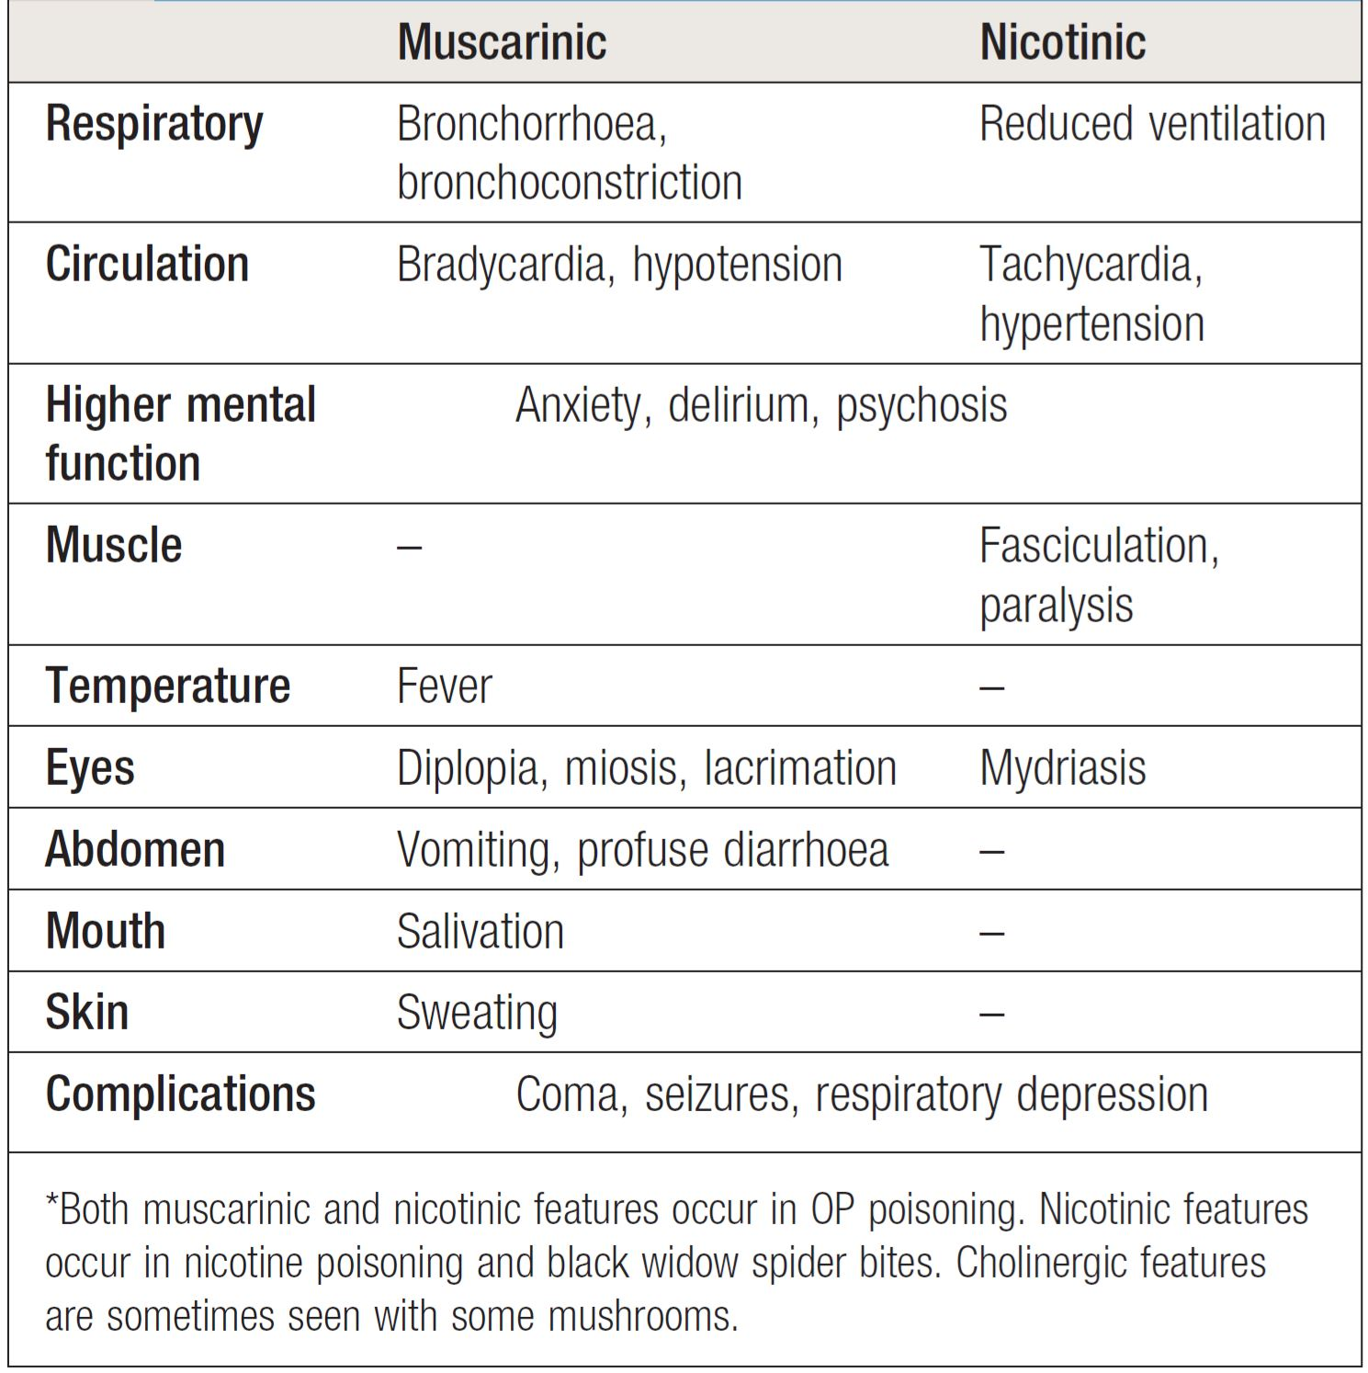
University of Basrah
Al-Zahraa College of Medicine
Ministry of higher Education and Scientific Research

Slide 28
University of Basrah
Al-Zahraa College of Medicine
Ministry of higher Education and Scientific Research
The airway should be cleared of excessive secretions, breathing and circulation assessed, high-flow oxygen administered and intravenous access obtained.
Appropriate external decontamination is needed.
Gastric lavage or activated charcoal may be considered if the patient presents sufficiently early.
The ECG, oxygen saturation, blood gases, temperature, urea and electrolytes,
amylase and glucose should be monitored closely.
Early use of sufficient doses of atropine is potentially life-saving in patients with severe toxicity. Atropine reverses ACh-induced bronchospasm, bronchorrhoea, bradycardia and hypotension.

Slide 29
University of Basrah
Al-Zahraa College of Medicine
Ministry of higher Education and Scientific Research
In severe poisoning requiring atropine, an oxime such as pralidoxime chloride is generally recommended, if available, although efficacy is debated. This may reverse or prevent muscle weakness, convulsions or coma, especially if given rapidly after exposure.
The acute cholinergic phase usually lasts 48–72 hours, with most patients requiring intensive cardiorespiratory support and monitoring.

Slide 30
University of Basrah
Al-Zahraa College of Medicine
Ministry of higher Education and Scientific Research
Intermediate syndrome
About 20% of patients with OP poisoning develop weakness that spreads rapidly from the ocular muscles to those of the head and neck, proximal limbs and the muscles of respiration, resulting in ventilatory failure.
This ‘intermediate syndrome’ generally develops 1–4 days after exposure, often after resolution of the acute cholinergic syndrome, and may last 2–3 weeks.
There is no specific treatment and supportive care is needed, including maintenance of airway and ventilation.
Organophosphate-induced delayed polyneuropathy??

Slide 31
University of Basrah
Al-Zahraa College of Medicine
Ministry of higher Education and Scientific Research
Methanol and ethylene glycol
Ethylene glycol is found in antifreeze, brake fluids and, in lower concentrations, windscreen washes.
Methanol is present in some antifreeze products and commercially available industrial solvents, and in low concentrations in some screen washes and methylated spirits. It may also be an adulterant of illicitly produced alcohol.
Both are rapidly absorbed after ingestion.
Methanol and ethylene glycol are not of high intrinsic toxicity but are converted via alcohol dehydrogenase to toxic metabolites that are largely responsible for their clinical effects.

Slide 32
University of Basrah
Al-Zahraa College of Medicine
Ministry of higher Education and Scientific Research
Early features of poisoning with either methanol or ethylene glycol Include
Vomiting
Ataxia
Drowsiness
Dysarthria
Nystagmus.
As toxic metabolites are formed, metabolic acidosis, tachypnoea, coma and seizures may develop.
Toxic effects of ethylene glycol include ophthalmoplegia, cranial nerve palsies, hyporeflexia and myoclonus.
Renal failure.
Methanol poisoning causes headache, delirium and vertigo.
Visual impairment and photophobia develop, associated with optic disc and retinal oedema and impaired pupil reflexes.

Slide 33
University of Basrah
Al-Zahraa College of Medicine
Ministry of higher Education and Scientific Research
The diagnosis can be confirmed by measurement of ethylene glycol or methanol concentrations but assays are not widely available.
An antidote, ideally fomepizole but otherwise ethanol, should be administered to all patients with suspected significant exposure while awaiting the results of laboratory investigations.
Haemodialysis or haemodiafiltration should be used in severe poisoning, especially if renal failure is present or there is visual loss in the context of methanol poisoning.

Slide 34
University of Basrah
Al-Zahraa College of Medicine
Ministry of higher Education and Scientific Research
Opioids
Toxicity may result from misuse of illicit drugs such as heroin or from intentional or accidental overdose of medicinal opiates.
Physical dependence occurs within a few weeks of regular high-dose use.
Withdrawal can start within 12 hours, causing intense craving, rhinorrhoea, lacrimation, yawning, perspiration, shivering, vomiting, diarrhoea and abdominal cramps.
Examination reveals tachycardia, hypertension, mydriasis and facial flushing.

Slide 35
University of Basrah
Al-Zahraa College of Medicine
Ministry of higher Education and Scientific Research
Use of the specific opioid antagonist naloxone (0.4–2 mg IV in an adult, repeated if necessary) may obviate the need for intubation.
Repeated doses or an infusion are often required because the half-life of the antidote is short compared to that of most opiates, especially those with prolonged elimination. Patients should be monitored for at least 6 hours after the last naloxone dose.

Slide 36
University of Basrah
Al-Zahraa College of Medicine
Ministry of higher Education and Scientific Research
Digoxin
Poisoning with digoxin is usually accidental, arising from prescription of an excessive dose, impairment of renal function or drug interactions.
Clinical features
Cardiac effects include tachyarrhythmia's (either atrial or ventricular) and bradycardias, with or without atrioventricular block. Ventricular bigeminy is common and atrial tachycardia with evidence of atrioventricular block is highly suggestive of the diagnosis.
Non-cardiacfeatures include delirium, headache, nausea, vomiting, diarrhoea
and (rarely) altered colour vision.
Digoxin poisoning can be confirmed by elevated plasma concentration (usual therapeutic range 1.3–2.5 mmol/L).
After chronic exposure, concentrations > 5 mmol/L suggest serious poisoning.

Slide 37
University of Basrah
Al-Zahraa College of Medicine
Ministry of higher Education and Scientific Research
Management
Activated charcoal.
Urea, electrolytes and creatinine should be measured, a 12-lead ECG performed and cardiac monitoring instituted.
Hypoxia, hypokalaemia (sometimes caused by concurrent diuretic use), hypomagnesaemia and acidosis increase the risk of arrhythmias and should be corrected.
Significant bradycardias may respond to atropine, although temporary pacing is sometimes needed.
Ventricular arrhythmias may respond to intravenous magnesium.
If available, digoxin-specific antibody fragments should be administered when there are severe refractory ventricular arrhythmias or bradycardias. These are effective for both digoxin and yellow oleander poisoning.

Slide 38
University of Basrah
Al-Zahraa College of Medicine
Ministry of higher Education and Scientific Research
Warfarin:
Warfarin is a vitamin K antagonist. It inhibits vitamin K epoxide reductase, which leads to inhibition of y carboxylation of precursor coagulation factors II, VII, IX, and X and proteins C and S.
Laboratory monitoring involves the prothrombin time and INR.
The major problems with warfarin are:
• a narrow therapeutic window
• metabolism that is affected by many factors
• numerous drug interactions.
Major bleeding is the most common serious side-effect of warfarin and occurs in 1–2% of patients each year.

Slide 39
University of Basrah
Al-Zahraa College of Medicine
Ministry of higher Education and Scientific Research
Management of warfarin bleeding:
• If the INR is above the therapeutic level, warfarin should be withheld or the dose reduced. If the patient is not bleeding, it may be appropriate to give a small dose of
vitamin K either orally or intravenously (1–2.5 mg), especially if the INR is greater than 8.
• In the event of bleeding, withhold further warfarin. Minor bleeding can be treated with 1–2.5 mg of vitamin K IV. Major haemorrhage should be treated as an emergency with vitamin K 5–10 mg slowly IV, combined with coagulation factor replacement This should optimally be a prothrombin complex concentrate (30–50 U/kg).

Slide 40
University of Basrah
Al-Zahraa College of Medicine
Ministry of higher Education and Scientific Research
Thank you

